Slide 1


Slide 2
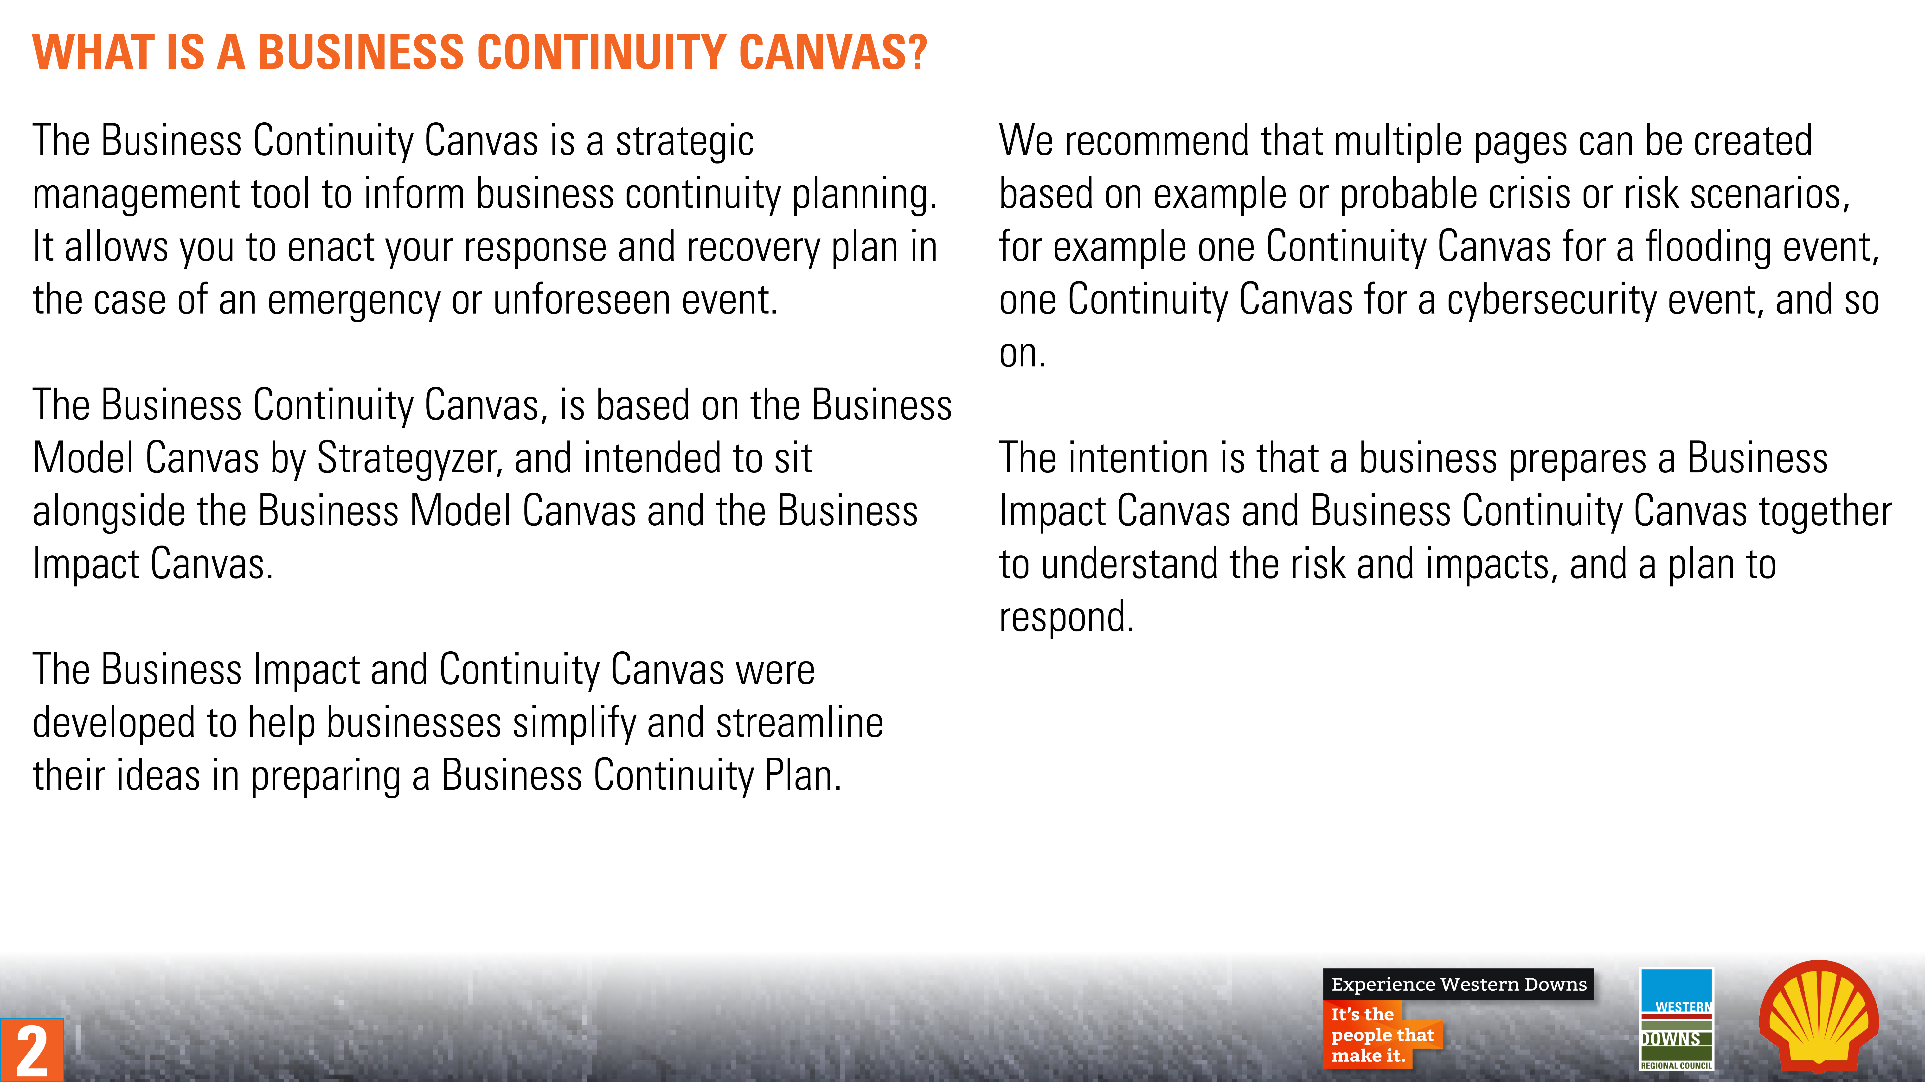
2

Slide 3
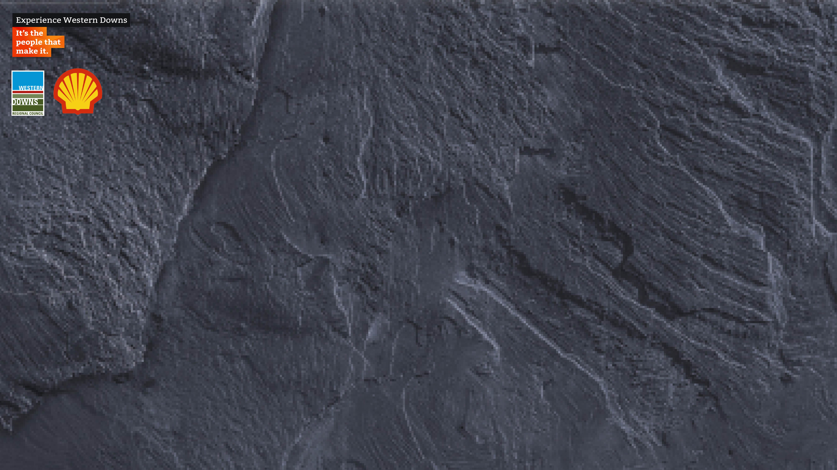
Business Continuity Canvas
Designed for:
Designed by:
Date:
Version:
Contacts and Partners
Comms Channels
Business Activities
Key Risks
Operations
How do we pivot our business operations?
Communication
How do we communicate?
Comms Plan
Resources, Assets or Locations
Insurances
Mission
Cash Outflow
Cash Inflow
Cash
How do we ensure financial stability?
3

Slide 4
Business Continuity Canvas
Designed for:
Designed by:
Date:
Version:
Contacts and Partners
Comms Channels
Business Activities
Key Risks
Internal
Xx
External
xx
Online
Xx
Offline
xx
Business activities/functions
Direct
Xx
Indirect
xx
Comms Plan
Resources, Assets or Locations
Insurances
Key audiences
Key messages
Key policy
Impact on resources
Mission
Cash Outflow
Cash Inflow
What do we need to review?
What do we need to do?
4

Slide 5


Slide 6
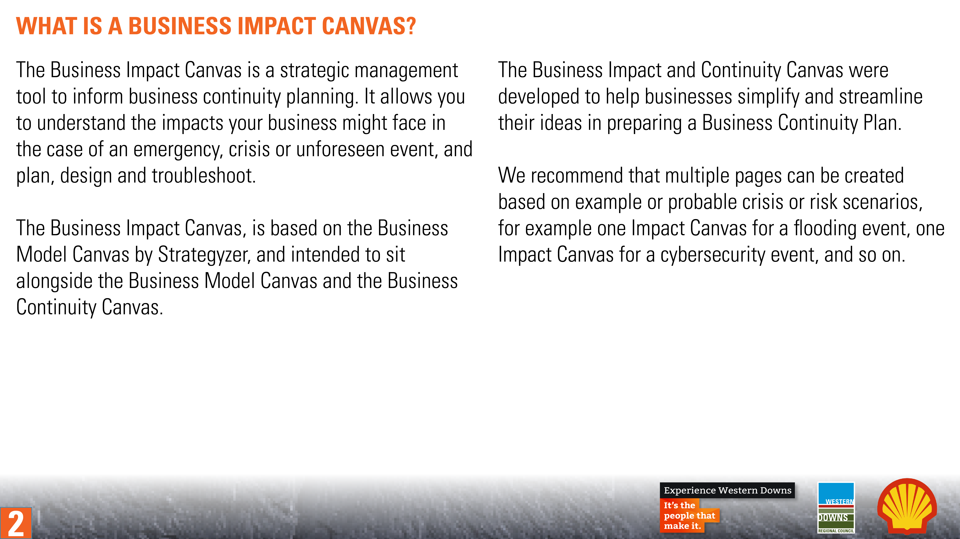
6

Slide 7
Business Impact Canvas
Designed for:
Designed by:
Date:
Version:
Contacts and Partners
Communication Channels
Business Activities
Key Risks
Online
Xx
Offline
xx
Communication
How it impacts our stakeholders, suppliers, partners, staff and customers.
Resources, Assets or Locations
Insurances
Operations
How it impacts our business operations.
Mission
Cash Outflow
Cash Inflow
Cash
How it impacts our business financial management and performance.
7

Slide 8
Business Impact Canvas
Designed for:
Designed by:
Date:
Version:
Contacts and Partners
Communication Channels
Business Activities
Key Risks
Internal
Xx
External
Suppliers
Online
Xx
Offline
xx
Business activities/functions
Direct
Xx
Indirect
xx
Communications Plan
Resources, Assets or Locations
Insurances
Internal
Key impacts
External
Key impacts
Key insurances that need to be activated
Impact on resources
Mission
Cash Outflow
Cash Inflow
Impact on cost structure
Impact on revenue
8

Slide 9


Slide 10
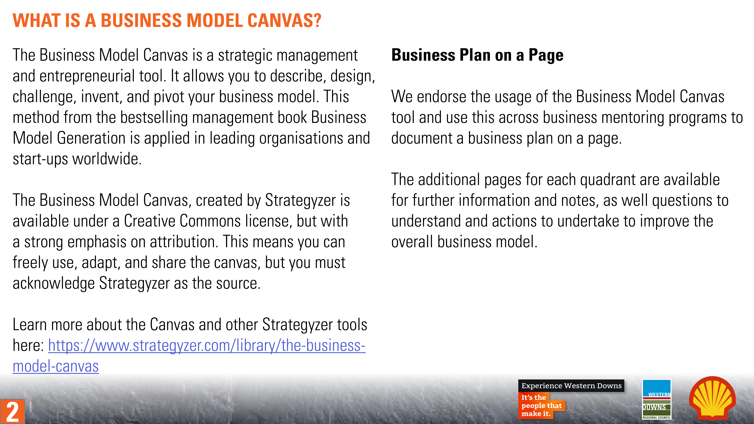
10

Slide 11












Business Model Canvas
Designed for:
Designed by:
Date:
Version:
KP
Key Partners
KA
Key Activities
VP
Value Proposition
CR
Customer Relationships
CS
Customer Segments
FEASIBILITY
DESIRABILITY
KR
Key Resources
CH
Channels
C$
Cost Structures
R$
Revenue Streams
VIABILITY
11
Business Model Canvas by Strategyzer AG is licensed under CC BY-SA 3.0.

Slide 12
Business Model Canvas
Designed for:
Designed by:
Date:
Version:
KP
Key Partners
KA
Key Activities
VP
Value Proposition
CR
Customer Relationships
CS
Customer Segments
FEASIBILITY
DESIRABILITY
The network of suppliers and partners that make the model work
The most important things we must do to make our model work
The products and services that create value for a specific Customer Segment
The types of relationships we establish with specific Customer Segments
The different groups of people or organisations we aim to reach and serve
KR
Key Resources
CH
Channels
The most important assets required to make our model work
How we communicate and reach Customer Segments to deliver Value Propositions
C$
Cost Structures
R$
Revenue Streams
VIABILITY
All the costs incurred to operate our model
The strategies we use to extract value from each Customer Segment
12
Business Model Canvas by Strategyzer AG is licensed under CC BY-SA 3.0.

Slide 13
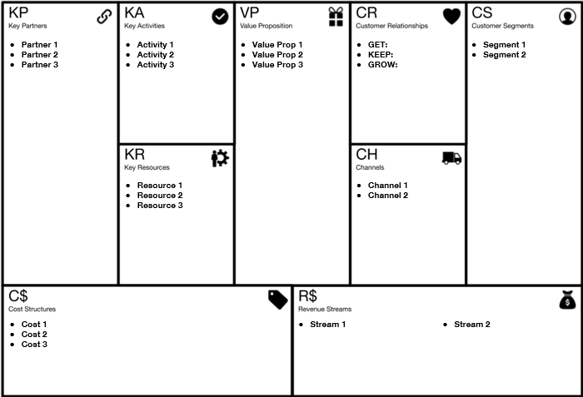
Business Model Canvas
Designed for:
Designed by:
Date:
Version:
13
Business Model Canvas by Strategyzer AG is licensed under CC BY-SA 3.0.

Slide 14
VP
Value Proposition
Notes
Questions
TO DO
TO DO
Assessment
TO DO
14

Slide 15
CS
Customer Segments
Notes
Questions
TO DO
TO DO
Assessment
TO DO
15

Slide 16
CH
Channels
Notes
Questions
TO DO
TO DO
Assessment
TO DO
16

Slide 17
CR
Customer Relationships
Notes
Questions
TO DO
TO DO
Assessment
TO DO
17

Slide 18
R$
Revenue Streams
Notes
Questions
TO DO
TO DO
Assessment
TO DO
18

Slide 19
KR
Key Resources
Notes
Questions
TO DO
TO DO
Assessment
TO DO
19

Slide 20
KA
Key Activities
Notes
Questions
TO DO
TO DO
Assessment
TO DO
20

Slide 21
KP
Key Partners
Notes
Questions
TO DO
TO DO
Assessment
TO DO
21

Slide 22
C$
Cost Structures
Notes
Questions
TO DO
TO DO
Assessment
TO DO
22

