Slide 1


Slide 2
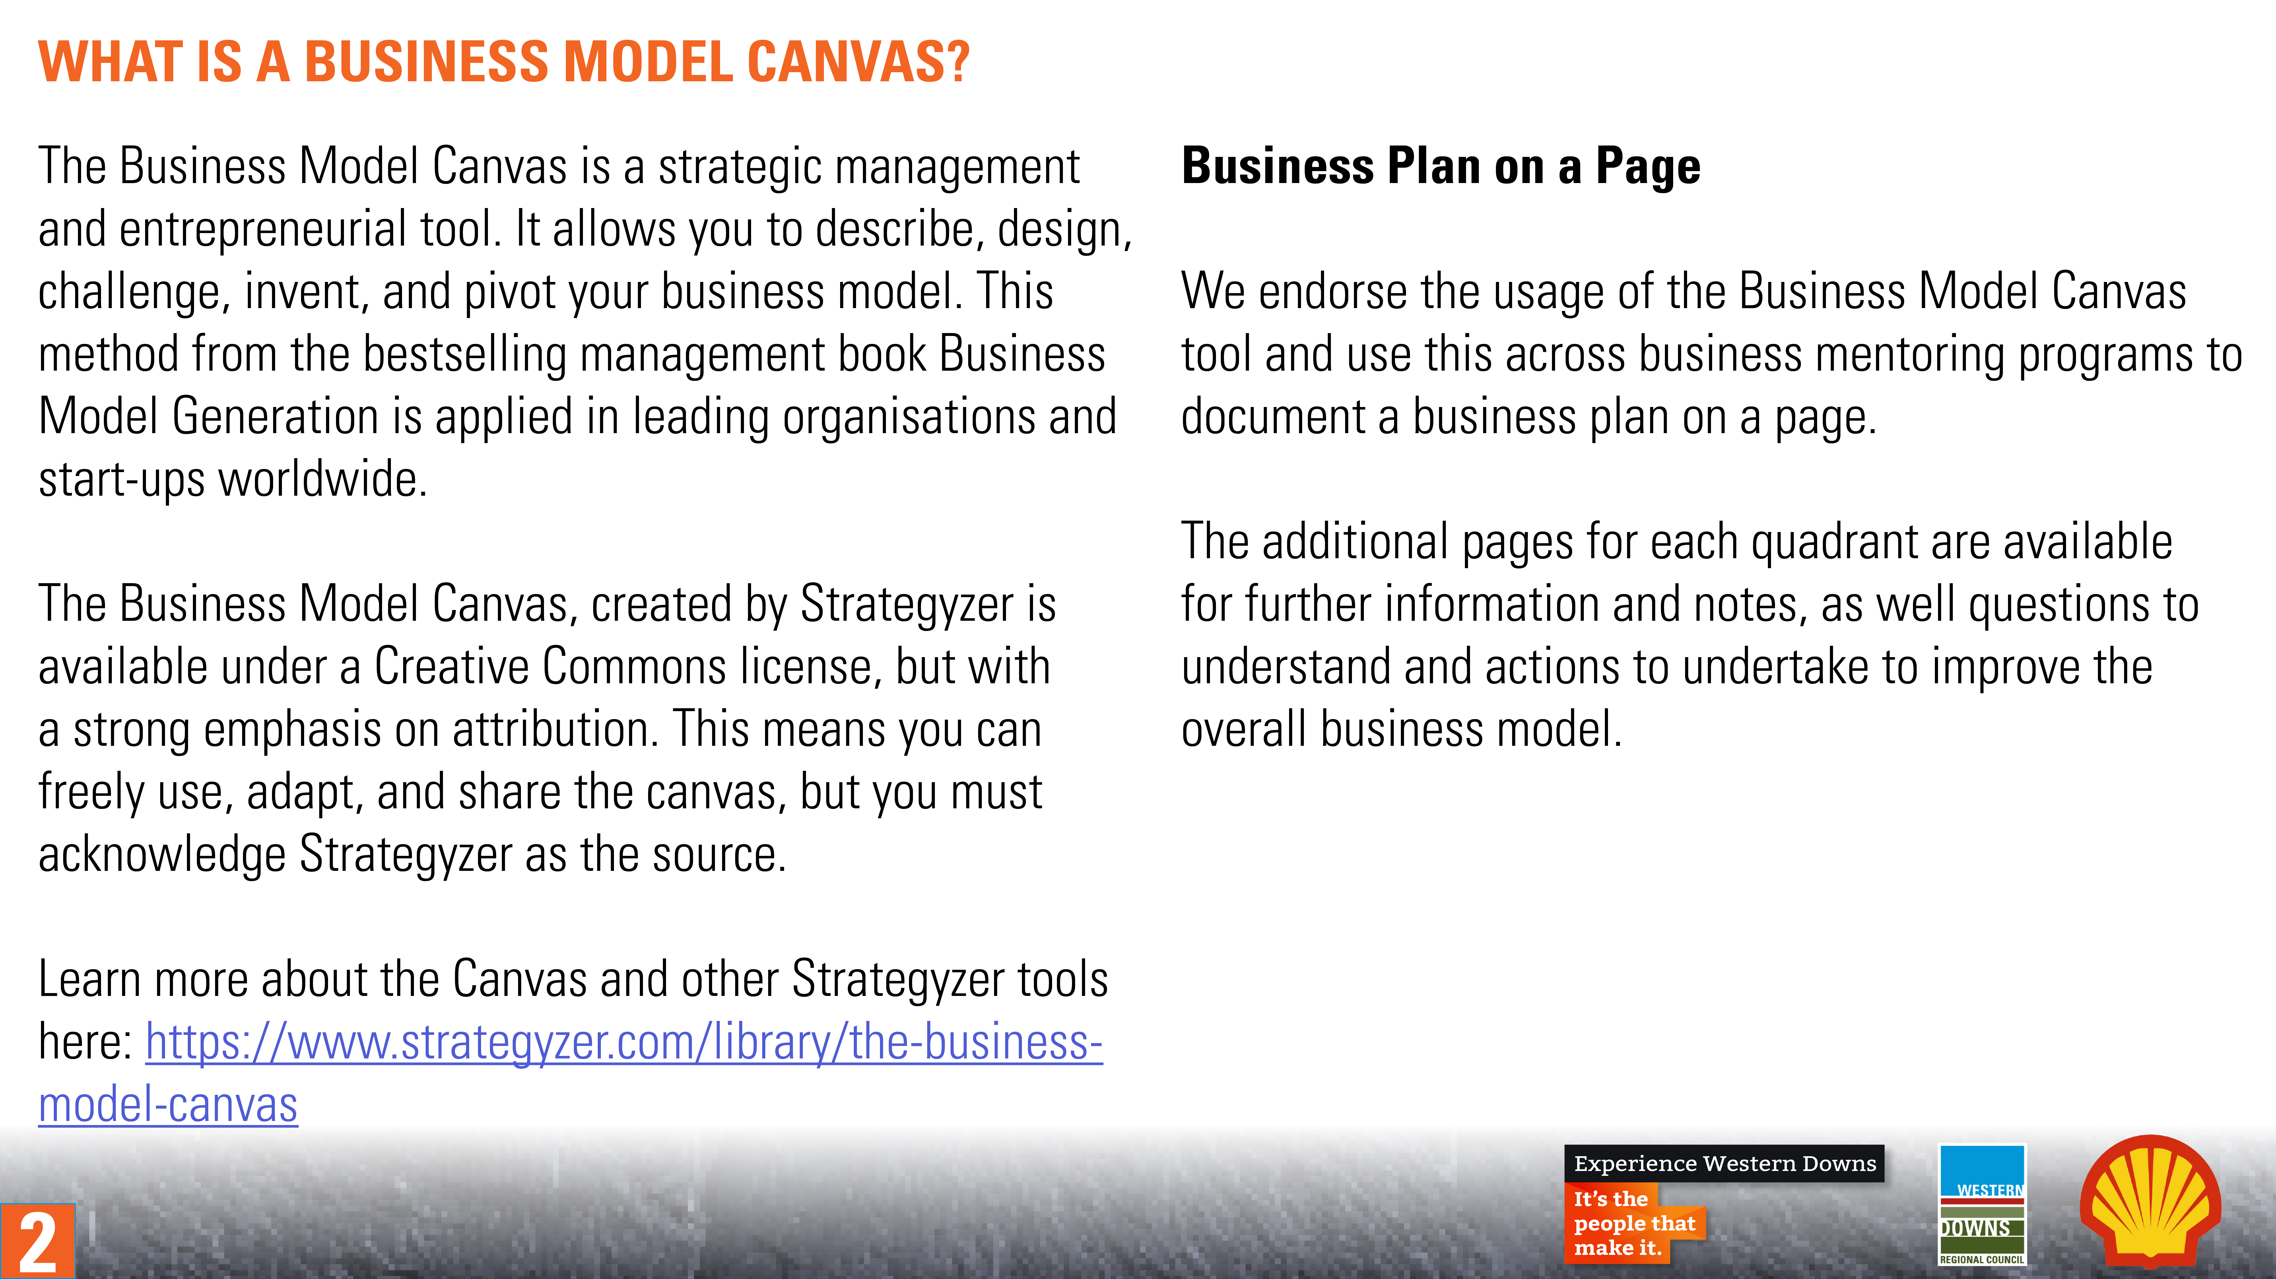
2

Slide 3
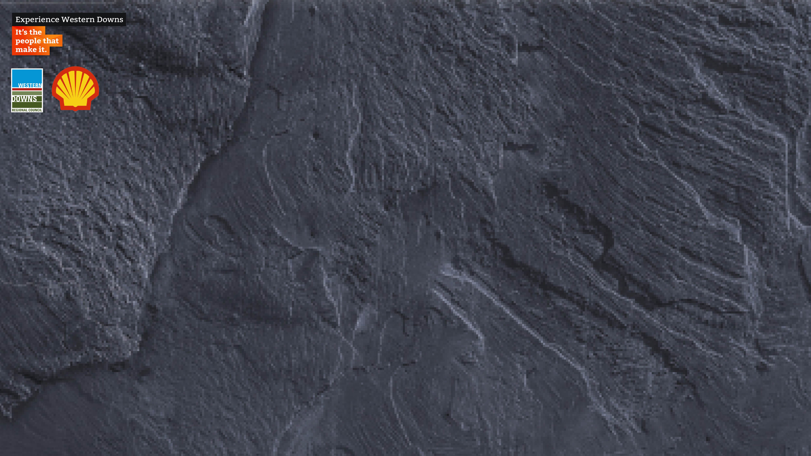












Business Model Canvas
Designed for:
Designed by:
Date:
Version:
KP
Key Partners
KA
Key Activities
VP
Value Proposition
CR
Customer Relationships
CS
Customer Segments
FEASIBILITY
DESIRABILITY
KR
Key Resources
CH
Channels
C$
Cost Structures
R$
Revenue Streams
VIABILITY
2
Business Model Canvas by Strategyzer AG is licensed under CC BY-SA 3.0.

Slide 4
Business Model Canvas
Designed for:
Designed by:
Date:
Version:
KP
Key Partners
KA
Key Activities
VP
Value Proposition
CR
Customer Relationships
CS
Customer Segments
FEASIBILITY
DESIRABILITY
The network of suppliers and partners that make the model work
The most important things we must do to make our model work
The products and services that create value for a specific Customer Segment
The types of relationships we establish with specific Customer Segments
The different groups of people or organisations we aim to reach and serve
KR
Key Resources
CH
Channels
The most important assets required to make our model work
How we communicate and reach Customer Segments to deliver Value Propositions
C$
Cost Structures
R$
Revenue Streams
VIABILITY
All the costs incurred to operate our model
The strategies we use to extract value from each Customer Segment
4
Business Model Canvas by Strategyzer AG is licensed under CC BY-SA 3.0.

Slide 5
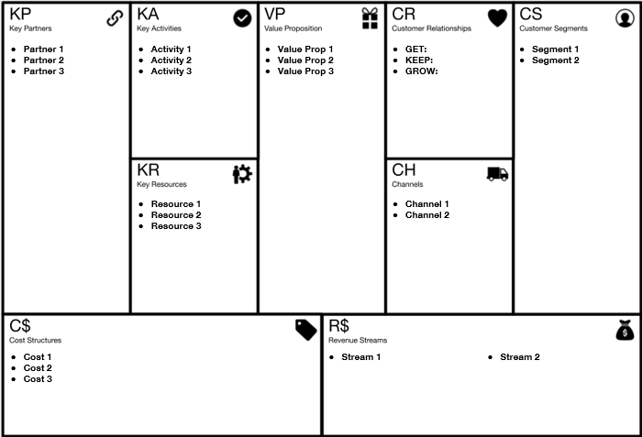
Business Model Canvas
Designed for:
Designed by:
Date:
Version:
5
Business Model Canvas by Strategyzer AG is licensed under CC BY-SA 3.0.

Slide 6
VP
Value Proposition
Notes
Questions
TO DO
TO DO
Assessment
TO DO
6

Slide 7
CS
Customer Segments
Notes
Questions
TO DO
TO DO
Assessment
TO DO
7

Slide 8
CH
Channels
Notes
Questions
TO DO
TO DO
Assessment
TO DO
8

Slide 9
CR
Customer Relationships
Notes
Questions
TO DO
TO DO
Assessment
TO DO
9

Slide 10
R$
Revenue Streams
Notes
Questions
TO DO
TO DO
Assessment
TO DO
10

Slide 11
KR
Key Resources
Notes
Questions
TO DO
TO DO
Assessment
TO DO
11

Slide 12
KA
Key Activities
Notes
Questions
TO DO
TO DO
Assessment
TO DO
12

Slide 13
KP
Key Partners
Notes
Questions
TO DO
TO DO
Assessment
TO DO
13

Slide 14
C$
Cost Structures
Notes
Questions
TO DO
TO DO
Assessment
TO DO
14

