Slide 1


Slide 2
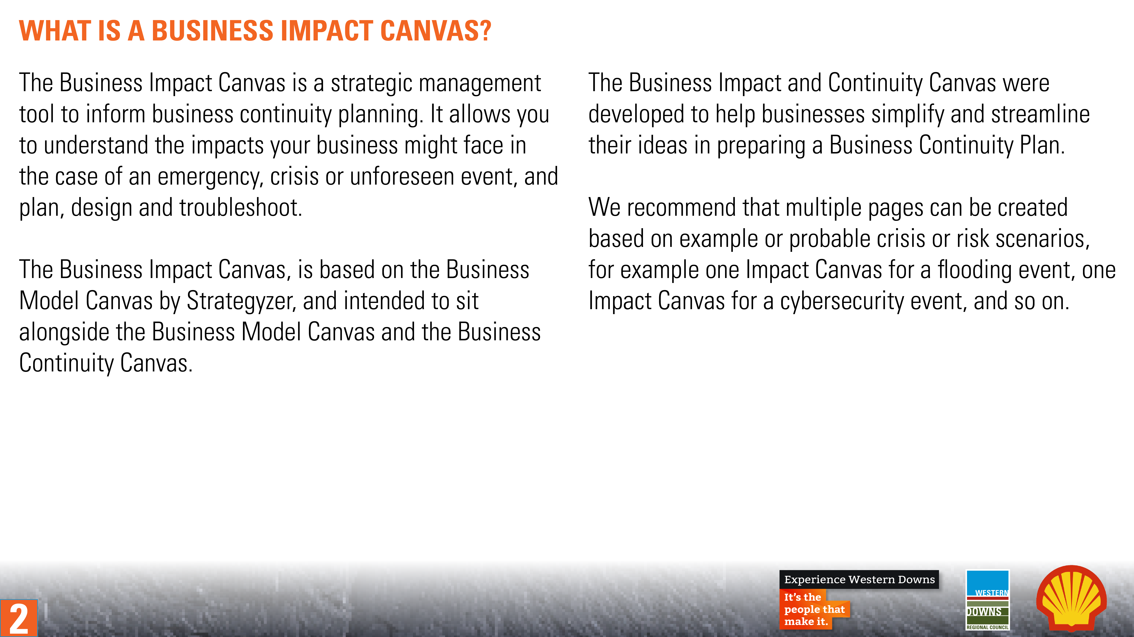
2

Slide 3

Business Impact Canvas
Designed for:
Designed by:
Date:
Version:
Contacts and Partners
Communication Channels
Business Activities
Key Risks
Online
Xx
Offline
xx
Communication
How it impacts our stakeholders, suppliers, partners, staff and customers.
Resources, Assets or Locations
Insurances
Operations
How it impacts our business operations.
Mission
Cash Outflow
Cash Inflow
Cash
How it impacts our business financial management and performance.
3

Slide 4
Business Impact Canvas
Designed for:
Designed by:
Date:
Version:
Contacts and Partners
Communication Channels
Business Activities
Key Risks
Internal
Xx
External
Suppliers
Online
Xx
Offline
xx
Business activities/functions
Direct
Xx
Indirect
xx
Communications Plan
Resources, Assets or Locations
Insurances
Internal
Key impacts
External
Key impacts
Key insurances that need to be activated
Impact on resources
Mission
Cash Outflow
Cash Inflow
Impact on cost structure
Impact on revenue
4

