Slide 1


Slide 2
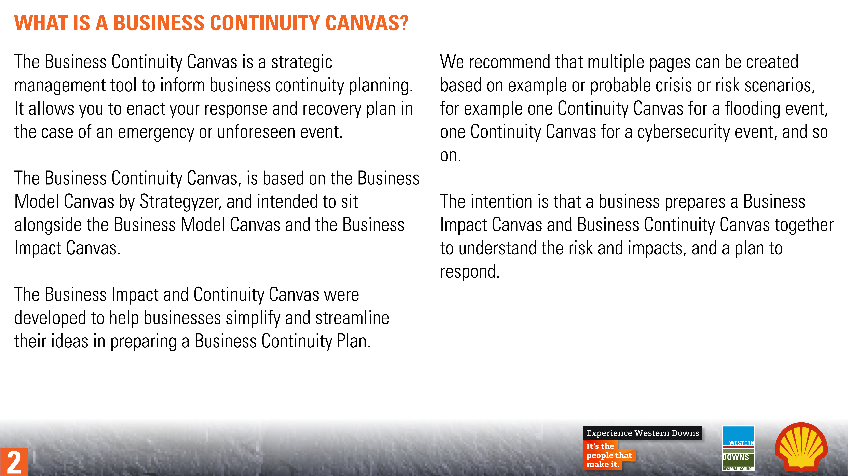
2

Slide 3

Business Continuity Canvas
Designed for:
Designed by:
Date:
Version:
Contacts and Partners
Comms Channels
Business Activities
Key Risks
Operations
How do we pivot our business operations?
Communication
How do we communicate?
Comms Plan
Resources, Assets or Locations
Insurances
Mission
Cash Outflow
Cash Inflow
Cash
How do we ensure financial stability?
3

Slide 4
Business Continuity Canvas
Designed for:
Designed by:
Date:
Version:
Contacts and Partners
Comms Channels
Business Activities
Key Risks
Internal
Xx
External
xx
Online
Xx
Offline
xx
Business activities/functions
Direct
Xx
Indirect
xx
Comms Plan
Resources, Assets or Locations
Insurances
Key audiences
Key messages
Key policy
Impact on resources
Mission
Cash Outflow
Cash Inflow
What do we need to review?
What do we need to do?
4

